Slide 1
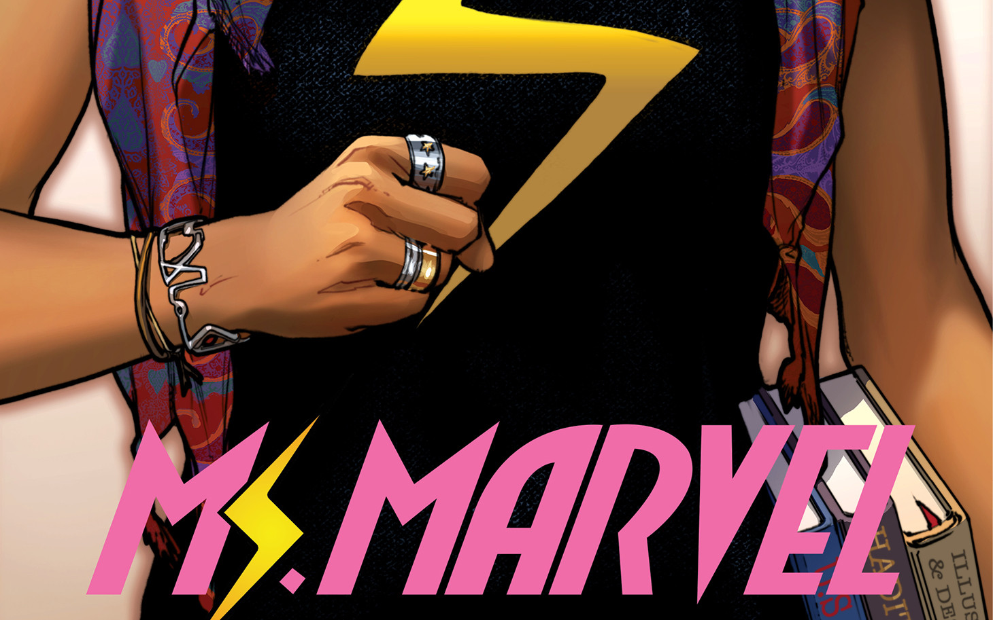
Ms. Marvel: No Normal “Everyone else gets to be normal: why cant i?”

Slide 2
Class Contemplation
What does it mean to “BE Yourself”?

Slide 3
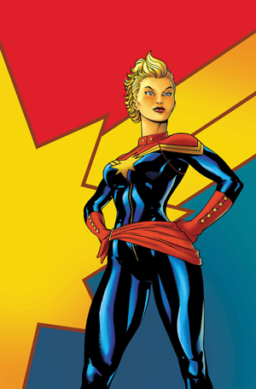
“Superman with Boobs?”
Here we have another renaissance era re-imagination of an existing superhero
It is an update of a classic comic book superhero
Re-boot of Carol Danvers, Captain Marvel / Ms. Marvel

Slide 4
Why Carol Danvers?
Super-heroine Ideal: Like Wonder Woman
Are we slaves to our conceptions of beauty & freedom rather than masters?
To what extent is our subjectivity constituted by popular culture?
Princess archetypes (idea of an archetype) doesn’t allow freedom to “be yourself”
It is an ideal; a universal; life is defined by that archetype—it is norm or model

Slide 5
Key issues
Typical American teenage girl experience
Alienation in the host country (a feeling of not belonging)
Pressure to assimilate in the host-society
Finding belonging
multiculturalism and cultural co-existence
Construction and maintenance of identity boundaries
Interplay between reality and fiction; imagination and real
Construction of women’s bodies
Gender non-conformity
Familial bonding
Veiling
Cultural stereotypes; Cultural othering; the idea of manufactured prejudice
Clash of cultures: humans are divided along cultural lines

Slide 6
Ms. Marvel’s Superpower
Kamala has polymorph superpowers (physical mutations)
Polymorphism (no death)
Induced by Terrigen Cloud
Metamorphosis plot—she morphs for power; in discovery of identity
effective metaphor that reflects her identity struggles
Malleability/mutability of identity
Identity is fluid, in flux, contingent

Slide 7
Power in being yourself
Work-in-progress
Identity and power (related)
Ms. Marvel not fully empowered
Not fully in control
She shape shifts her entire body, or just limbs to keep her human appearance
The core message—reinforced through her power—is to “be yourself”
She is in the process of coming to terms with her hybridity and her own “difference”
Core word: mutation (also in X-Men)

Slide 8
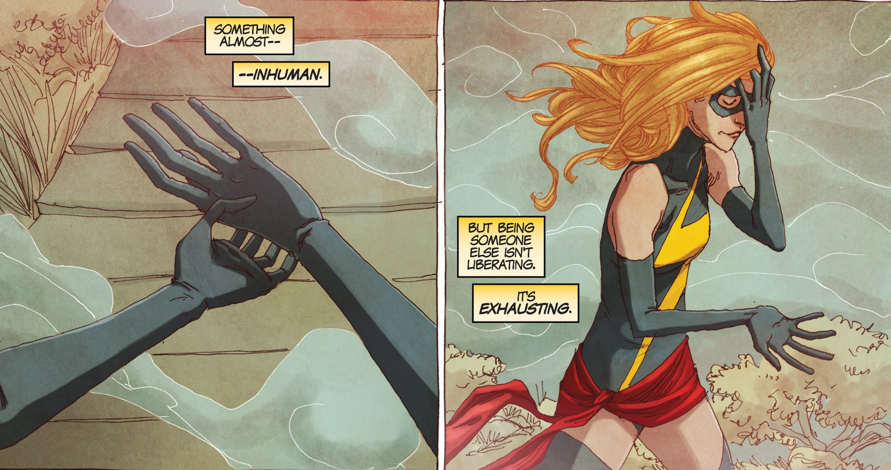
Emotional & Physical power
When does she embiggen and shrink (“disembiggen”)?
Significance?
Does her level of control over her powers change throughout the text?
“It’s like having a completely new sense…It’s something much weirder” (vol. 2; p.11)

Slide 9
Ms. Marvel and Spiderman
Self-acceptance is key issue
Seek acceptance from others: need validation
Journey: heroes don’t need to be anyone else to be brave or acceptable
Confidence not derived through imitation of others
Costume: in progress
Legitimacy of Heroic identity: in progress
Both are makeshift at first
Both are “normal” teenagers
Both make their own costumes

Slide 10
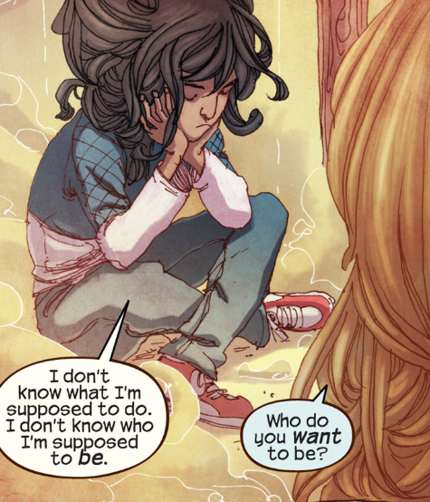
Who am I?
Shape shifts into Carol Danvers
Feels most safe being a white superhuman ideal
A comment on society
Whiteness=acceptance, safety, and visibility
Standard of beauty

Slide 11
Identity
identity can be looked as a process
Identity is a combination of biology (fetal experience, infancy, childhood) & the actual events that happen to an individual
PLUS, the combination of social, cultural struggles, political events, & actual happenings in time, that join together to influence two things:
How your surrounding culture views itself in relation to other cultures/ to the rest of the world
How does it encourage, educate, persuade into interpreting things around us in a particular way?

Slide 12
Ideal of Freedom (embedded in our culture)
Be Yourself
Know Thyself
Modern dictum
Self-definition
You ought to be yourself
Normative
Cultural encoding
Behavioural codes
socialization
Ancient-classical dictum
Nosce te ipsum (Know thy self” (self-definition)
You ought to know yourself
Normative
Matter of virtue/character

Slide 13
“Be Yourself”
Kamala: “Being someone isn’t liberating, it’s exhausting”
“Be Yourself”: Everywhere, omnipresent—culture is saying it
Normative expectations of society
Why is this dictum perverse?
Assumption: that we are not ourselves
Anxiety—abt cruelty of it all: if you start to be yourself, you may stick out & be punished for it
Encouraged to be yourself, but not too individualistic

Slide 14
“Be Yourself, but not too much!”
How do we know when we are truly being ourselves?
What tells us? We depend on others to tell us
Implies a limitation
What is the limitation? How will be know it?
Behavioural, outward codes
Perform your codes well
So we can see it (notion of visually making sense)

Slide 15
Ms. Marvel: Good or Bad Learner?
Can we see her conformity?
Does she perform it or behave it well?
It is safe to conform: Carol Danvers is safe / no risk / she is already established ideals (like Iron Man)
Her journey:
Phase 1: Wants the norm,
Phase 2: Cant be the norm; cant imitate it well—early rejection of the norm
Phase 3: refusal to imitate the norm; “NO NORMAL by intent; no longer want to be identified as other; as not that

Slide 16
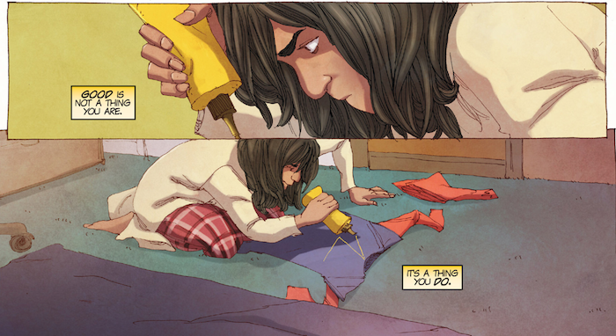
Self-Fashioning
Self-acceptance
We “fashion” our own identities
Are their biological barriers to “self” creation

Slide 17
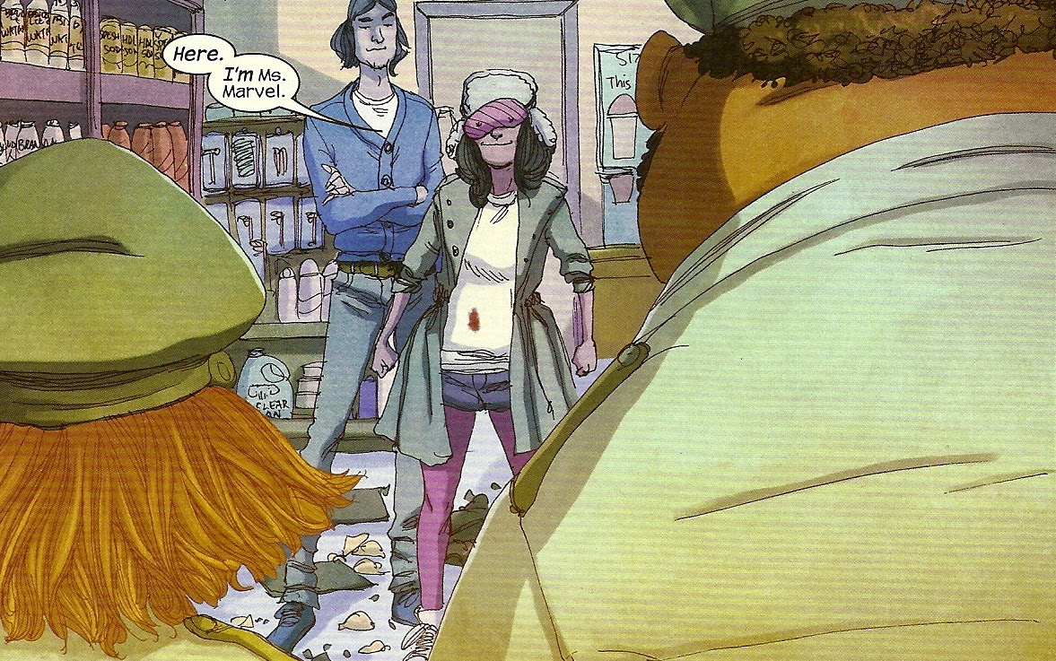
I’m Ms. Marvel: Take 1

Slide 18
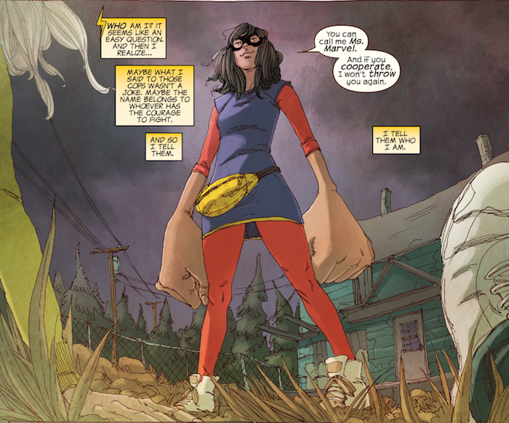
I’m Ms. Marvel: Take 2

Slide 19
Gender Studies
Identity/gender as role-play and performance
Judith Butler, Gender Trouble (1990); Bodies That Matter (1993)
Gender is naturalized, fixed, stable
Gender is a social construction
Gender models demand conformity

Slide 20
Judith Butler: NO (such thing as) NORMAL
Models of behaviour (how to be or know our selves)—demand conformity
Essentialist view: underneath the layers of social construction, there is a true self
Butler disagrees –she rep’s a nominalist view
We are nothing but our social constructions (layers and layers)
Her goal is to “denature” gender

Slide 21
Butler: Performativity
We imitate or perform our gender on a daily basis
The daily performance reproduces social constructions
A repetitive act produces gender norms
Subversion: a failure to imitate correctly
Drag: subversive b/c it imitates explicitly
Drag exposes gender as categories

Slide 22
Stereotypes
Power and domination and the way they function comes from the power of names/categories
The power to name is the very root of domination
What we and how we are named is that which against we struggle
Stereotypes are not accurate depictions of reality, but they have profound effects on reality
They are based in reality but they have real social consequences
They place people in roles and you get this societal typecasting that is inescapable
It is a system of representation that has a cyclical effect—it reproduces itself over again

Slide 23
Binaries
Relationships of opposition
The way we make sense of things
By placing things and people into knowable and understandable categories—it is the way we structure society so that we understand difference
Leads to hierarchical relationships; generates stereotypes
Superiority vs inferiority
Examples of binaries constructions:
Male/female; white/black; upper class/lower class; European/non-European; First World/Third World; rational/emotional

Slide 24
Hybridity
If it is hybrid, it is not one-sided, not binaristic
Hybridity undoes binaries
Manifest “double consciousness”
X-men—mutants are hybrids
Mutants are given a heritage
Kamala Khan has a cultural heritage
Not only Pakistani; not only American; but both

Slide 25
Metaphor & Motif
Cocoon
Birds (cultural encoding)
The trash
The mist
Insertion of Urdu
“doll face”; blank face

Slide 26
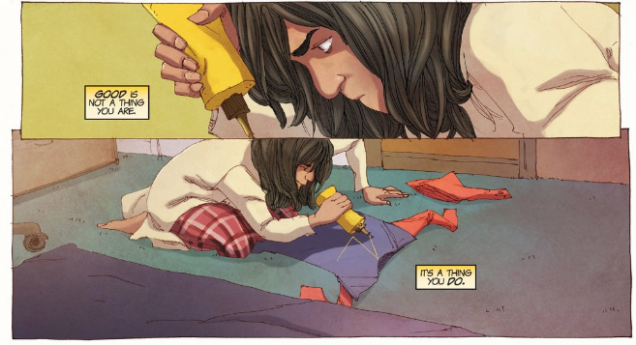
Word bubbles (colour) (virtue)

Slide 27
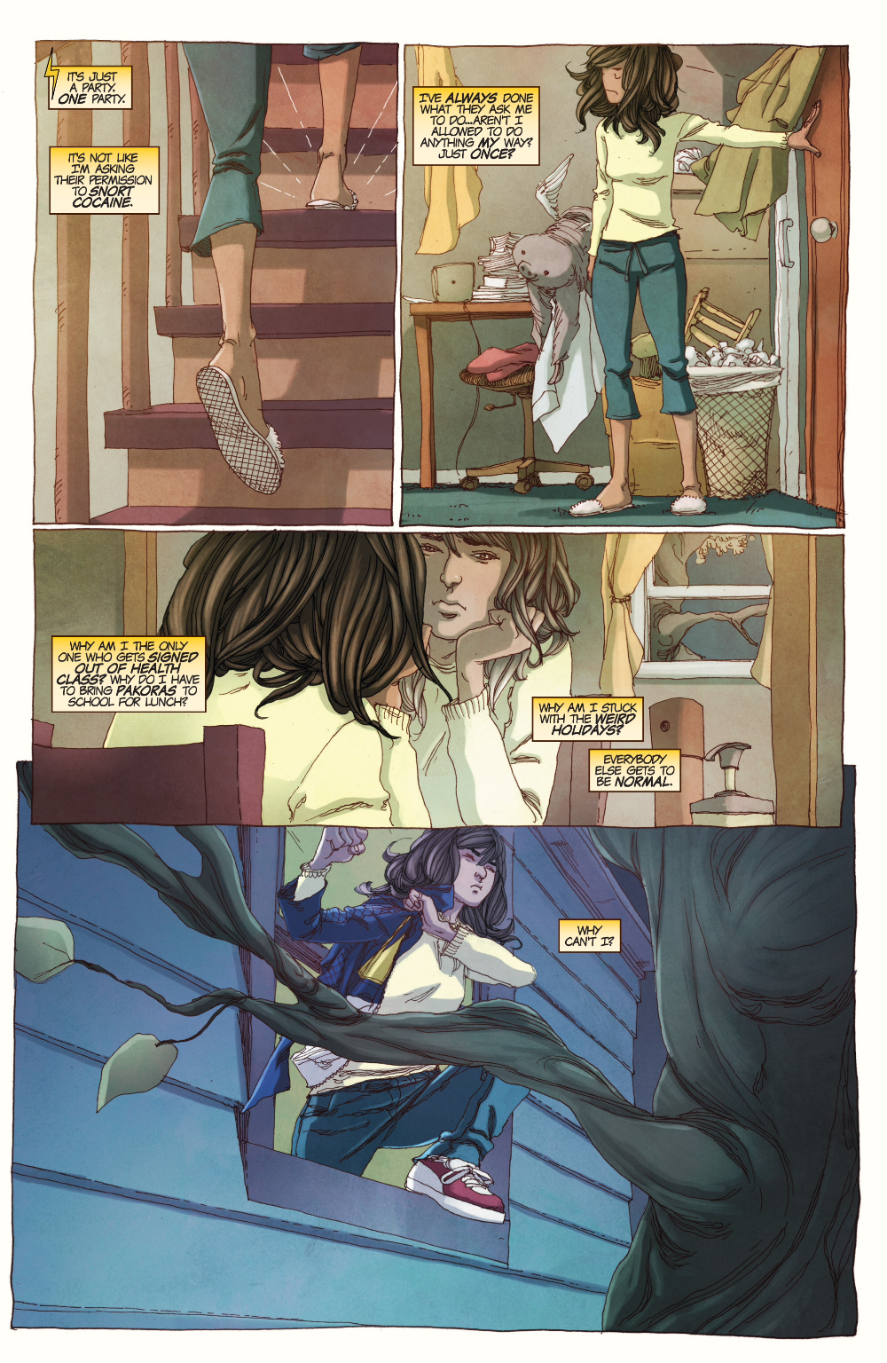
Vol. 1p. 8

Slide 28
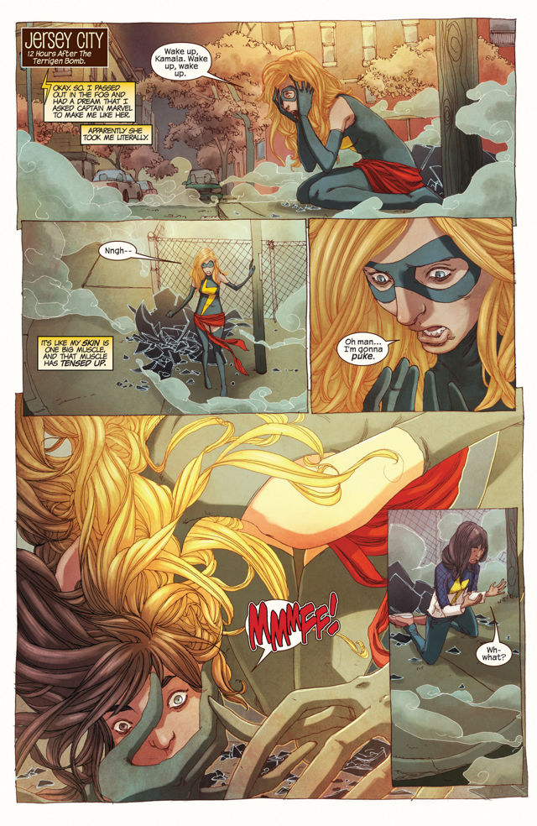
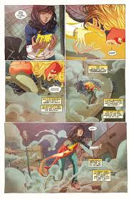
Vol. 2

Slide 29
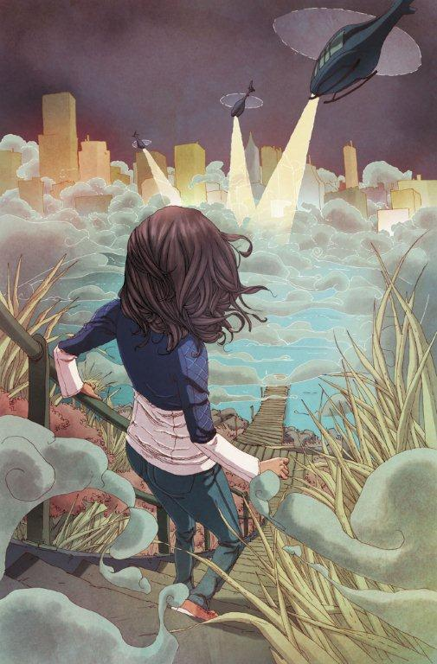
Vol. 2 (Secrets)

